Slide 1
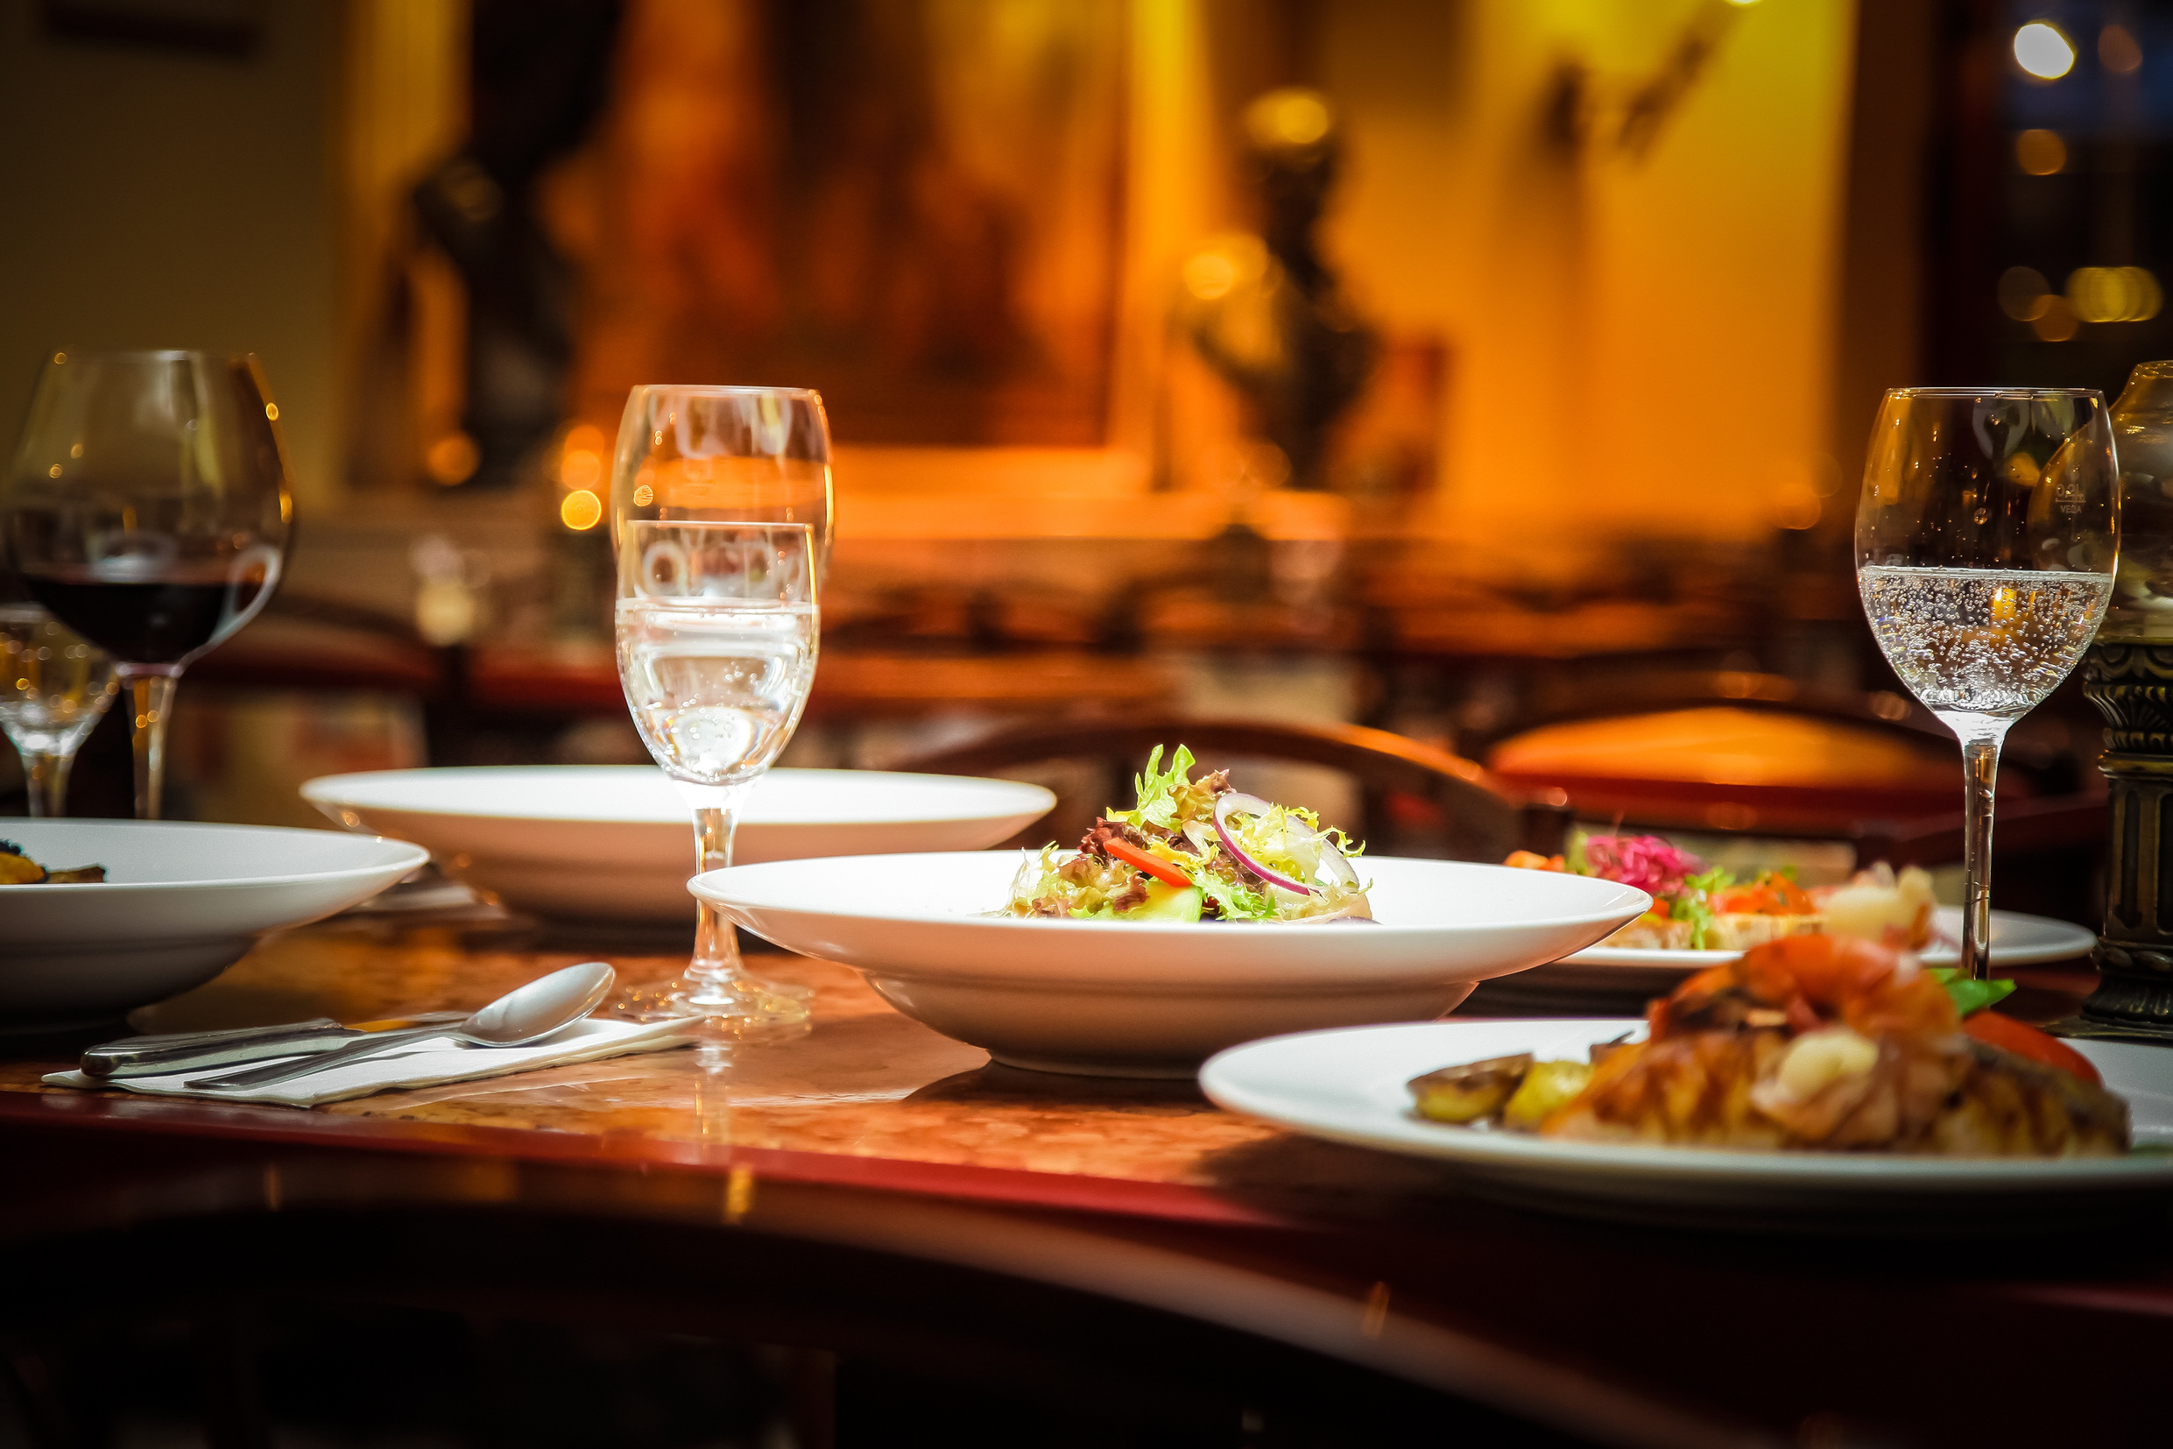
Global
Restaurant Analysis
TEAM-5
Aishwarya Kasar
Gayatri Dandge
Komal Gaikwad
Shreya Salunke

Slide 2
Level 1-Task 1
DATA EXPLORATION AND PREPROCESSING

Slide 3
Handle missing values in Data
By Handling missing values in each column (mean, median, mode - imputations our dataset becomes more complete and usable for analysis.
Accuracy in decision making (analysis becomes correct ,affect the decision such as customer segmentation,resource allocation)
Customer satisfaction(prevent distruption in analysis)

Slide 4
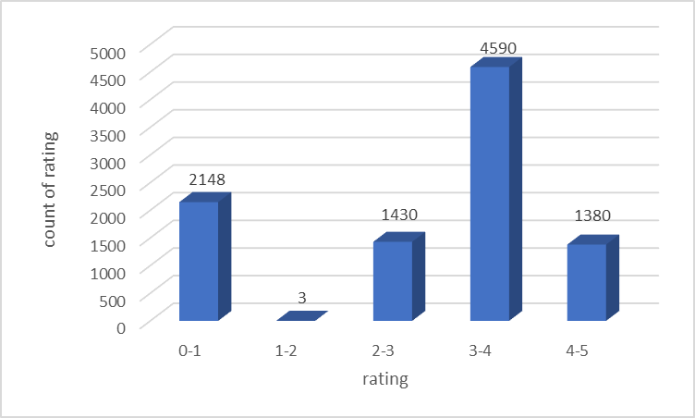
Analyzing Aggregate Rating Distribution & Visualizing Class Imbalances
Here we can see that people usually do not prefer rating between 1 to 2.
If the dish is not upto their liking they prefer rating 0 to 1 else gives a higher rating comparatively

Slide 5
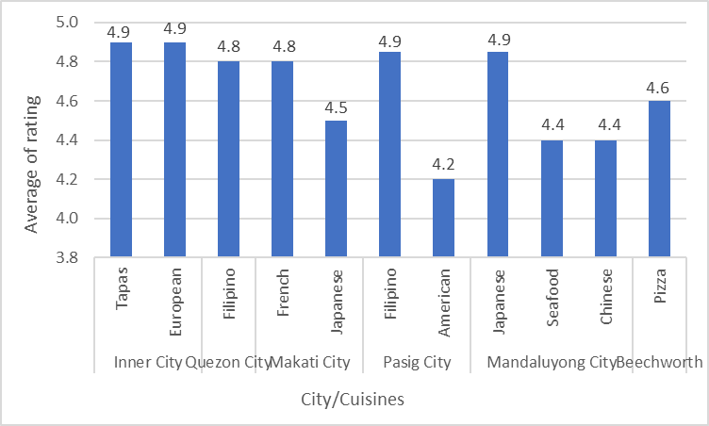
Comparing Cuisine & City Average Ratings: Top 2 Cuisines per City
People prefer eating their traditional dishes more.
It can be because of the ingredients ,and the method of cooking ,etc.

Slide 6
Analysis of cuisine type vs rating relationship
We can say that people usually rate higher to their traditional/country dishes.

Slide 7
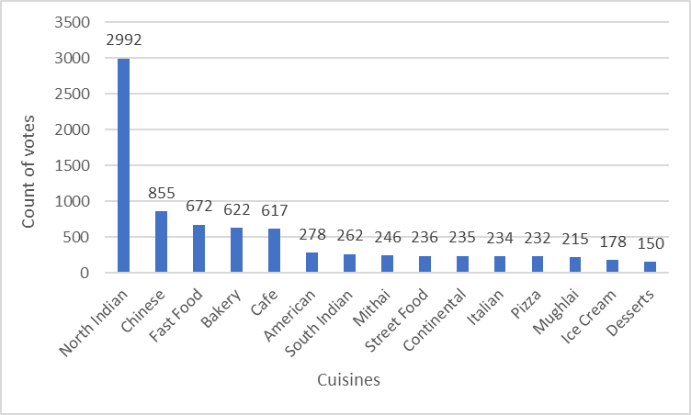
Most popular cuisines by vote count
We can say that people voted for cuisine, they like most or by which they get satisfied
Here the cuisine which have more vote count that cuisine is most popular cuisine with respect to the vote count.

Slide 8
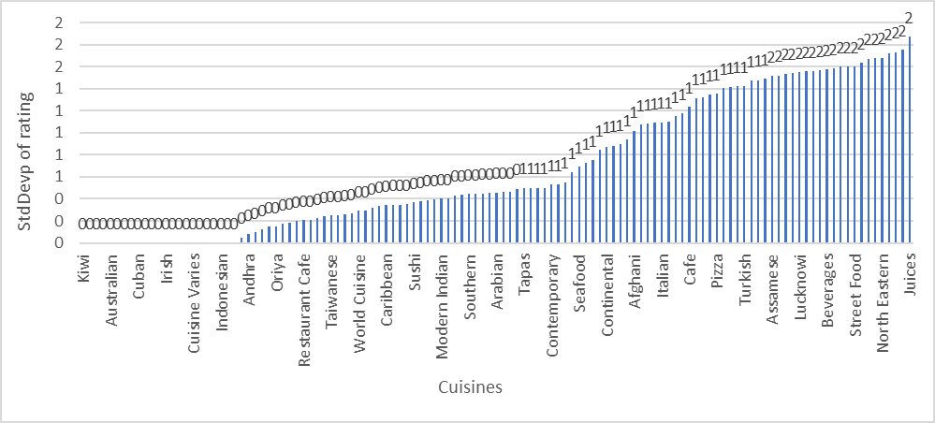
Cuisines with consistently higher ratings
Here, the cuisine that has lower value have consistently higher rating.
Where, cuisine that has higher value ,these cuisine do not have consistent higher ratings.

Slide 9
Level 1-Task 2
DESCRIPTIVE ANALYSIS

Slide 10
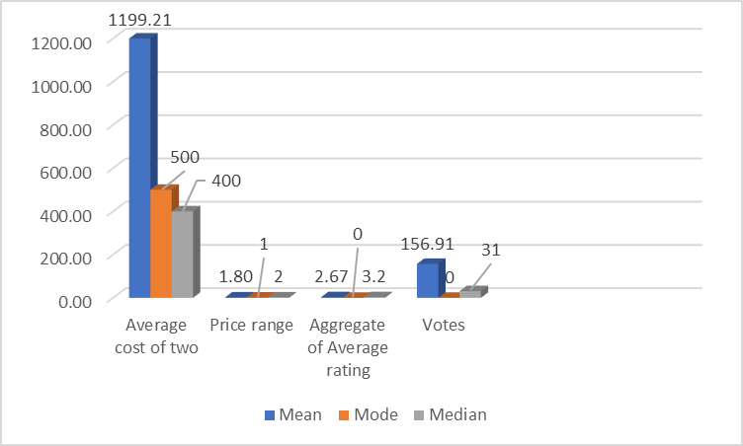
Basic statistical measures for numerical column
Average cost of two lies between 500 to 1200
Most given Price range is 1.
All restaurants have Average rating between 2 to 3.
Average given votes are around 156

Slide 11
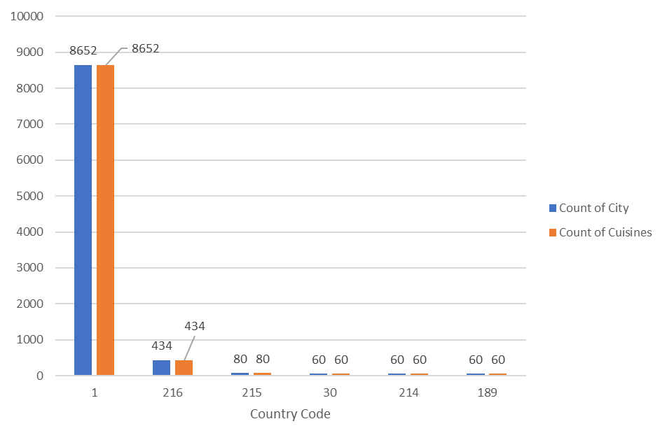
Distribution of categorical variables (Country Code, City, Cuisines)
The identical number of Count of cities and Count of cuisines demonstrates that each city for that country code contributes at least one unique cuisine.
Country with code 1 have the greatest number of cities 8652, which gives identical 8652 unique cuisines.

Slide 12
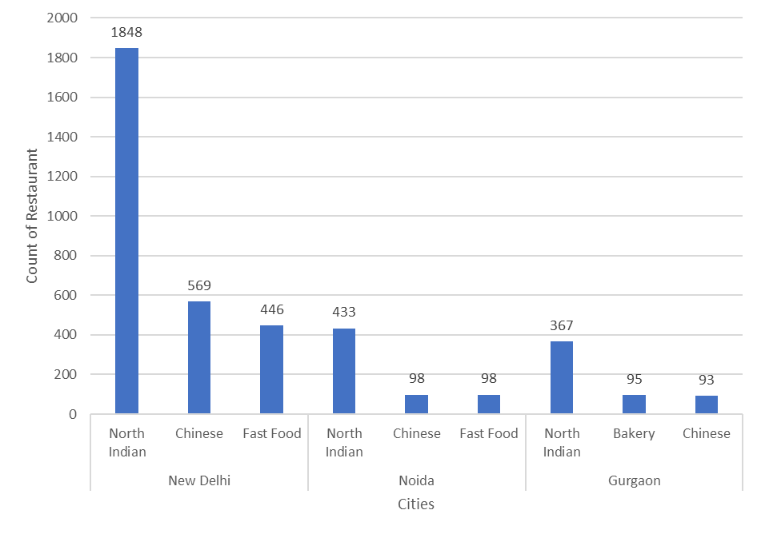
Top 3 cuisines and cities with highest restaurant counts
•Diverse Food Culture
•Urban Development
•Higher Population & Tourism
•Consumer Preferences
•More regional preferences
New Delhi, Noida, Gurgaon belongs to same Country code 1 having more similar cuisines and higher number of restaurants count, preferring North Indian Food due to regional preferences.

Slide 13
Level 1-Task 3
GEOSPATIAL ANALYSIS

Slide 14
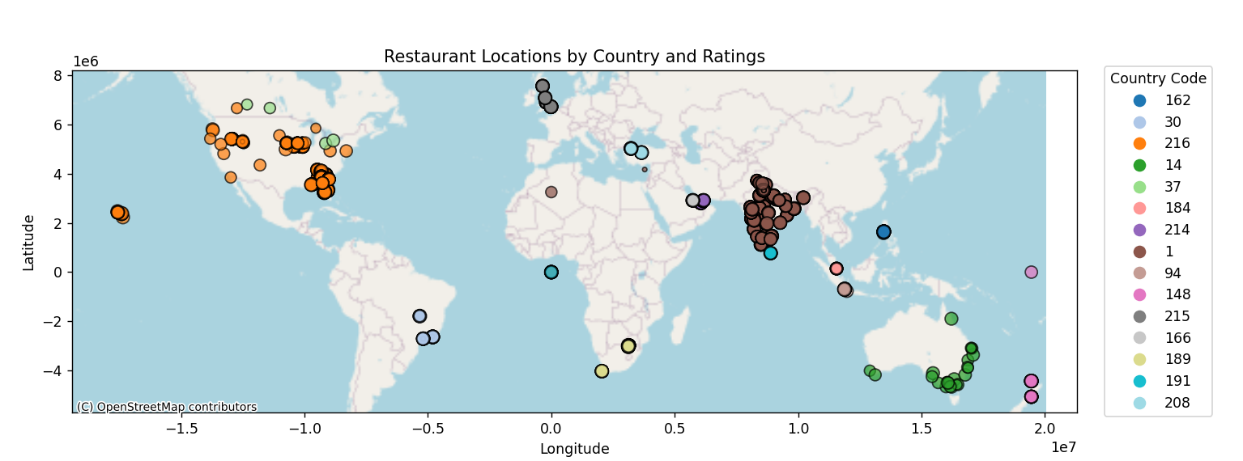
Restaurant Locations Based on Ratings
This map shows the highest and lowest rated restaurants.
Each country is represented by a unique color.
The size of the circle corresponds to the ratings:
Higher ratings have larger circles.
Lower ratings have smaller circles.

Slide 15
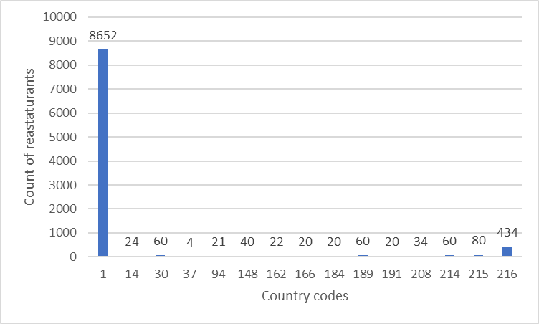
Restaurant distribution across countries
This data indicates the number of restaurants in each country.
Country code 1 has the highest number of restaurants.
Country code 216 has a moderate number of restaurants.
The remaining countries have fewer than 100 restaurants.

Slide 16
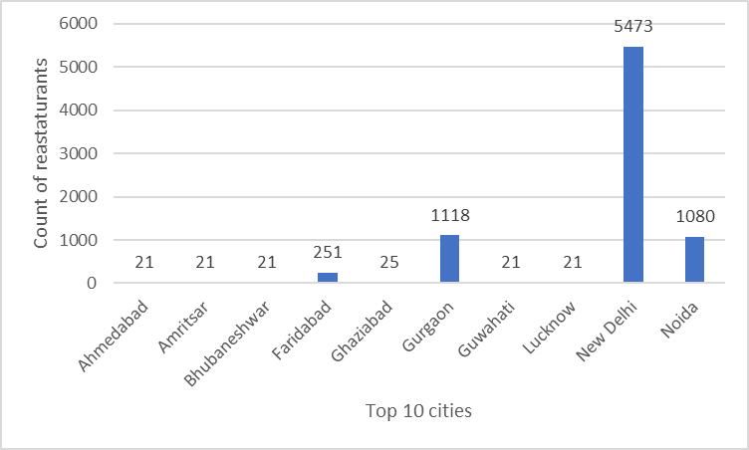
Restaurant distribution across cities
New Delhi has the highest number of restaurants.
Gurgaon and Noida have 1118 and 1080 restaurants, respectively.
Faridabad has a moderate number of restaurants, with 251 in total.
All remaining cities have fewer than 100 restaurants.
These are the top 10 cities in India with the highest number of restaurants.
16

Slide 17
Country code | Average of Aggregate rating
1 | 2.523324087
14 | 3.658333333
30 | 3.763333333
37 | 3.575
94 | 4.295238095
148 | 4.2625
162 | 4.468181818
166 | 4.06
184 | 3.575
189 | 4.21
191 | 3.87
208 | 4.3
214 | 4.233333333
215 | 4.0875
216 | 4.00437788
Grand Total | 2.666370014
Correlations between location and ratings
Close to 1 → Strong positive correlation
Close to -1 → Strong negative correlation
Close to 0→ No significant relationship
Correlation : 0.643171833
This data shows a strong positive correlation.

Slide 18
Level 2-Task 1
TABLE BOOKING AND ONLINE DELIVERY

Slide 19
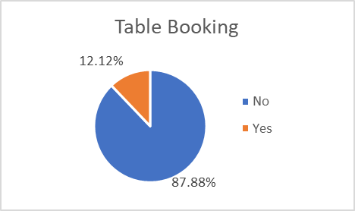
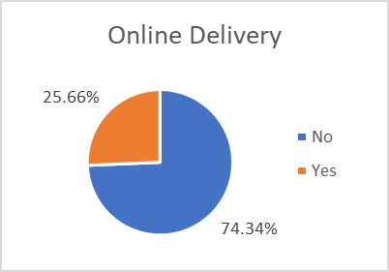
Restaurants offering TABLE BOOKING and ONLINE DELIVERY services
Here, we can see that yet ther are many restaurants that do not provide table booking service and online delivery services.

Slide 20
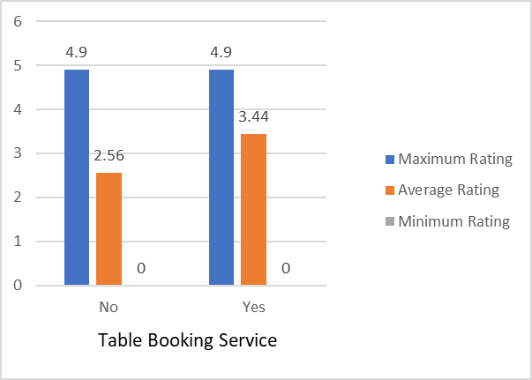
Impact of Table Booking on Restaurant Ratings
Restaurants which provide these
services have comparatively higher
average ratings.

Slide 21
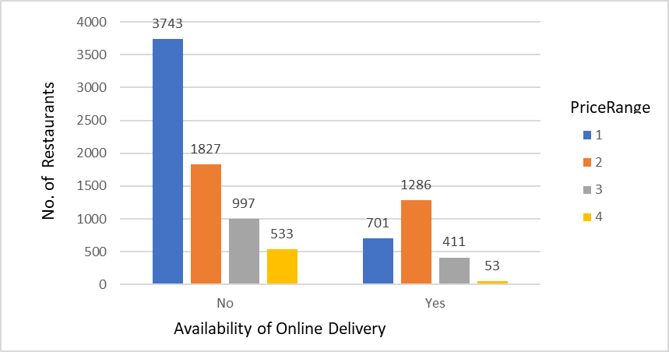
Online Delivery Availability Across Price Ranges
As we can see , there are many restaurants across all the price range that do not have online delivery service, these can lead to :
Revenue loss
Impact on growth
As, people prioritize convenience over price , it is suggest to keep the online services , and keep up with the market trends& technologies.

Slide 22
Level 2-Task 2
PRICE RANGE ANALYSIS

Slide 23
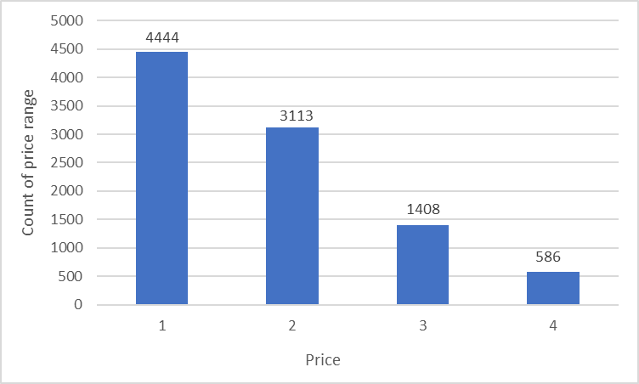
Most common price range
Count of price range 1 is more so we can say that the price 1 is the most common price.
Providing cuisines for cheap rates also helps to boost sales.
Count of price range is less for price 4 so this is a least common price range.

Slide 24
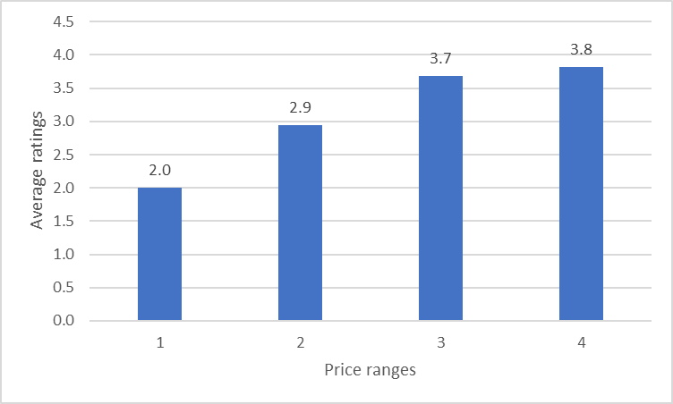
Average rating per price range
Lower price range restaurants have lower ratings, while higher price range restaurants have higher ratings.
High-price restaurants offer quality services and ensure customer satisfaction.
Budget-friendly restaurants do not offer the same level of quality or customer satisfaction, leading to lower ratings.

Slide 25
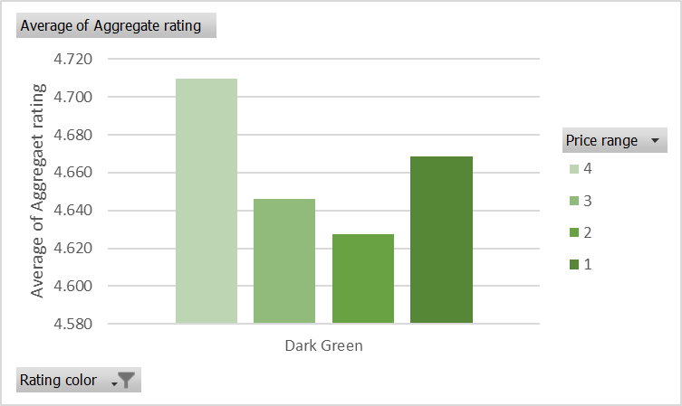
Color representing highest average rating among price ranges
Dark Green: 4.5-5.0
Green: 4.0-4.5
Yellow: 3.5-4.0
Orange: 3.0-3.5
Red: 2.0-2.5
White: 0.0
Average of Aggregate rating for all price ranges lies between 4.5 to 5.0 specifies Dark Green color.

Slide 26
Abstraction from analysis
India has the highest number of highly rated restaurants, and New Delhi has the most restaurants in India.
Most of the restaurants have average Aggregate rating between 4 to 5
People are yet not familiar with the use of technologies to provide online services, which can help them boost their business.

Slide 27
THANK YOU

